Slide 1


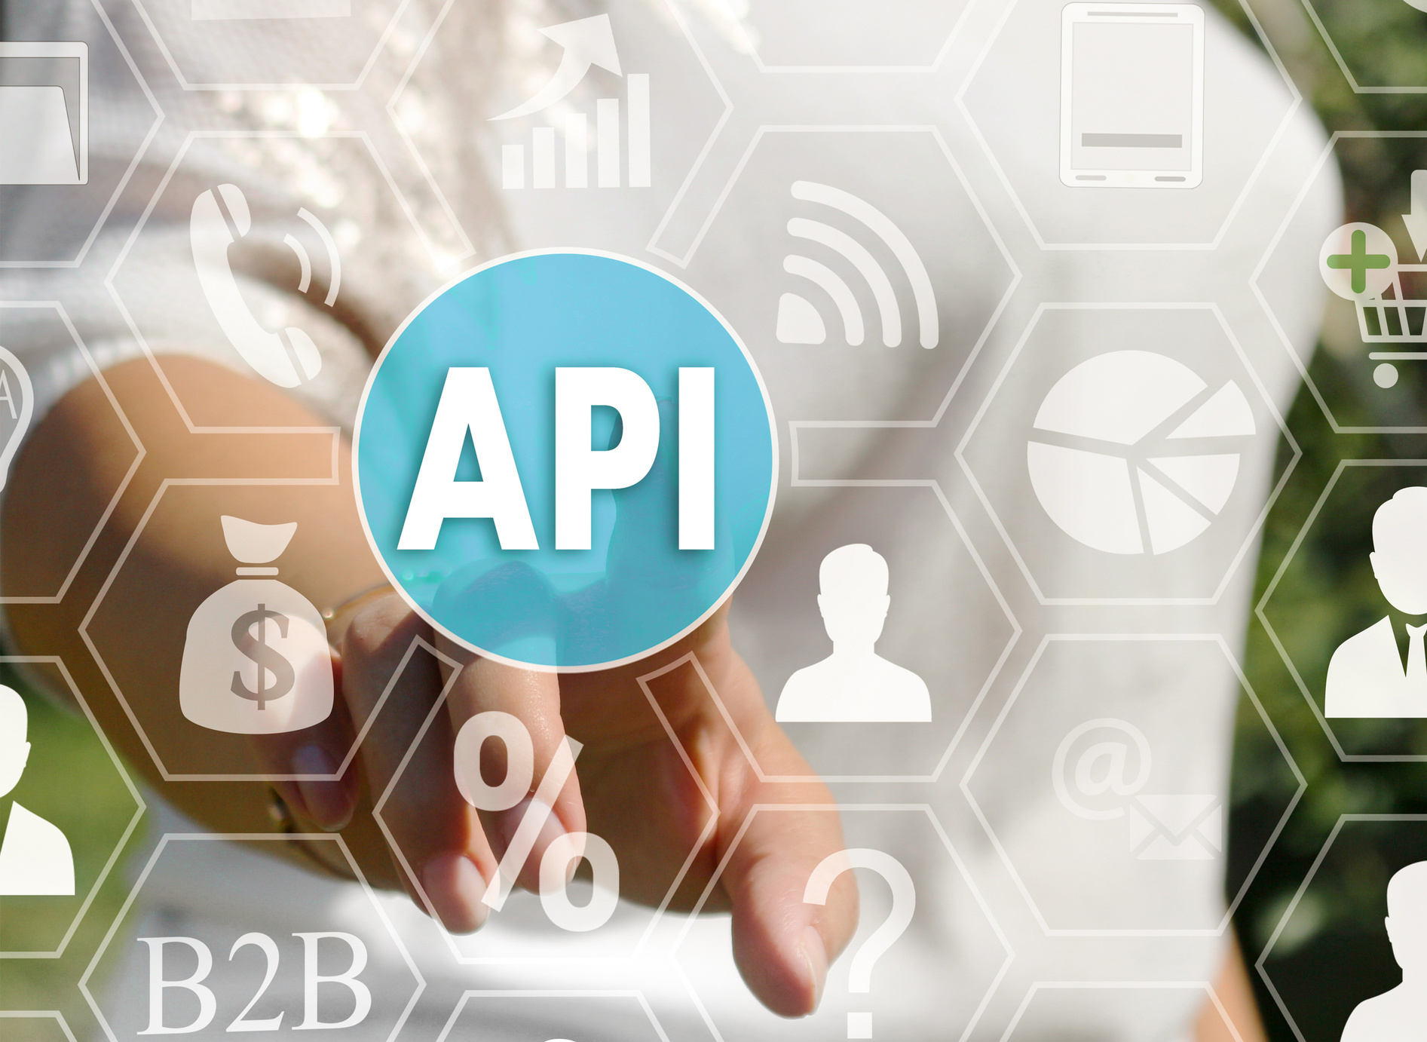
REST APIs and GraphQL

Slide 2

Objectives
GraphQL Fundamentals
How does graphQL work?
Work with GraphQL APIs

Slide 3

Objectives
Working with GraphQL Schema and Query
Consuming Rest APIs
Understand how GraphQL playground works

Slide 4

What is GraphQL?

Slide 5


What is GraphQL?
GraphQL is a query language for your API, and a runtime for fulfilling those queries with your existing data.
Features of GraphQL:
No over fetching and under fetching.
Single Endpoint.
Validates the query within the GraphQL type system before execution.

Slide 6
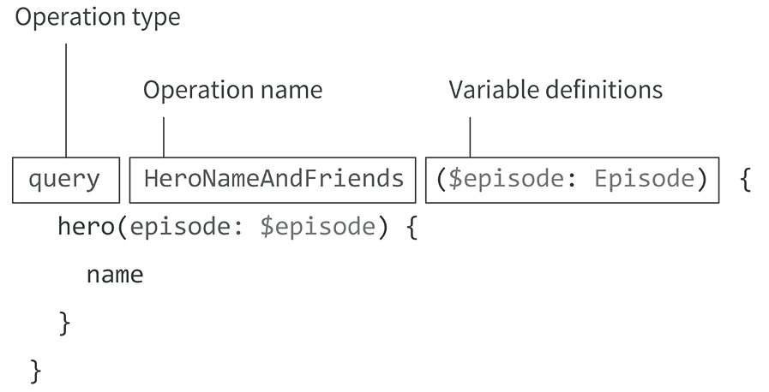
GraphQL Query Structure

Slide 7
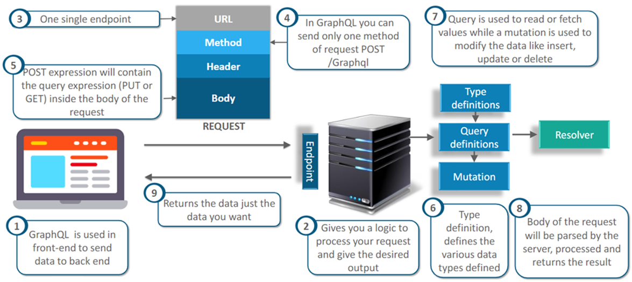
How does GraphQL work?

Slide 8

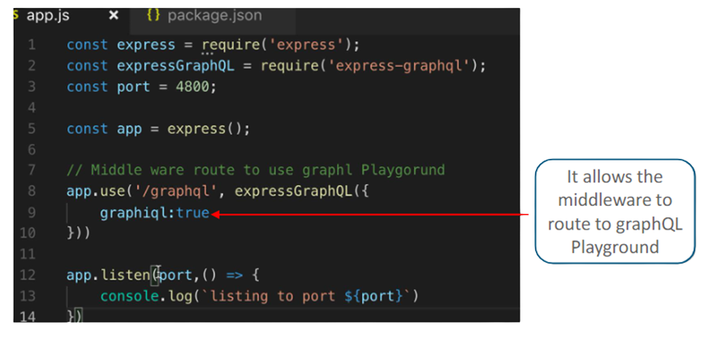
Working with GraphQL API
To add GraphQL in Middleware, install a package name express-graphQL as it is used to create the GraphQL HTTP server with any HTTP web framework that supports connect styled middleware.

Slide 9
GraphQL Schema
The schema describes the functionality that is available to the clients who connect to it.
Schema has the ability to:
Create relationships between types (Example: companies and Users)
Define which data fetching and data manipulation (mutating) operations can be executed by the client.
If desired, self-explain what capabilities are available to the client through the prior observation

Slide 10
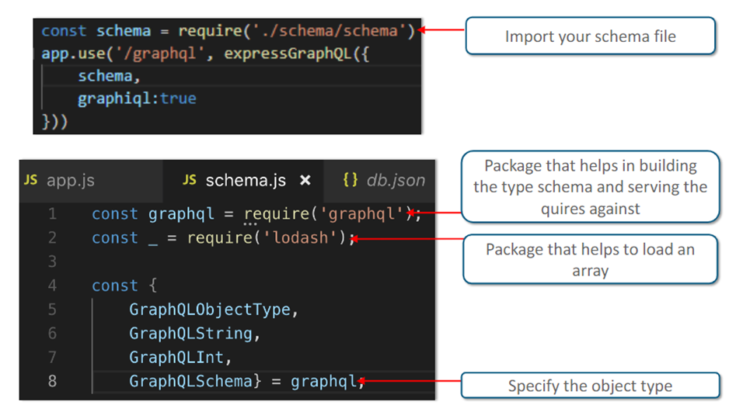
GraphQL Schema

Slide 11
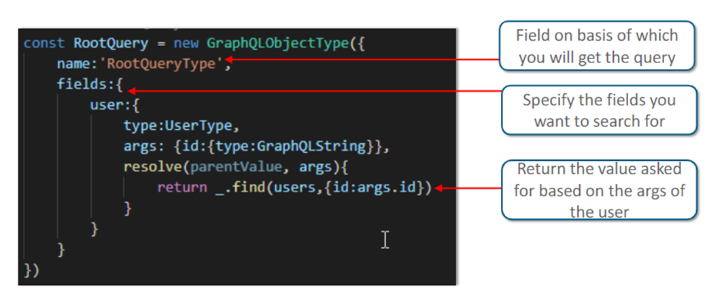
GraphQL Query
In GraphQL all the possible queries or entries into the GraphQL API is called Root Type or Query Type.

Slide 12
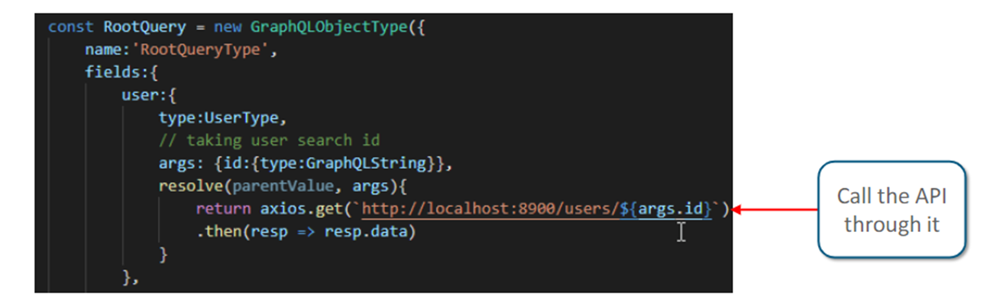
Calling API in GraphQL
To get the data from the API install axios/fetch.

Slide 13

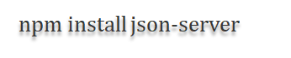

Creating API using Json-Server
To create an API in your localhost, you need to install Json-server:
Create a JSON file and add some sample content to it.
Run Json file with below command:

Slide 14
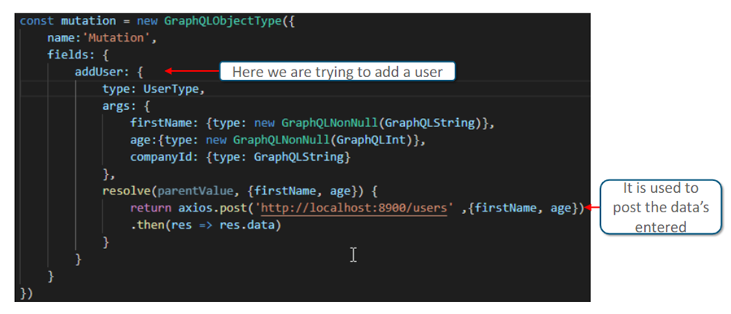
GraphQL Mutation
Mutations are operations sent to the server to create, update or delete data. These are comparable to the PUT, POST, PATCH, and DELETE verbs on REST-based APIs.

Slide 15
GraphQL Playground

Slide 16
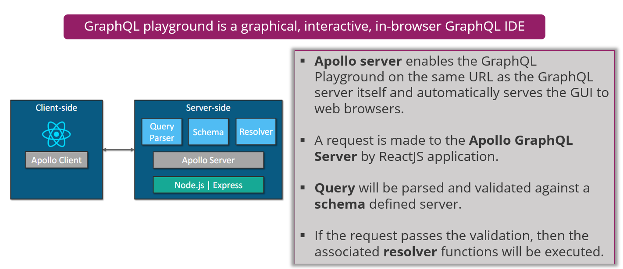
GraphQL Playground

Slide 17

Thank you!

